Slide 1
Polaris Sight
Live Forensics & Incident Response System
OWEN CHARTERS
PEIJUN XUE
RUI LIN
CURTIS DOOLEY

Slide 2
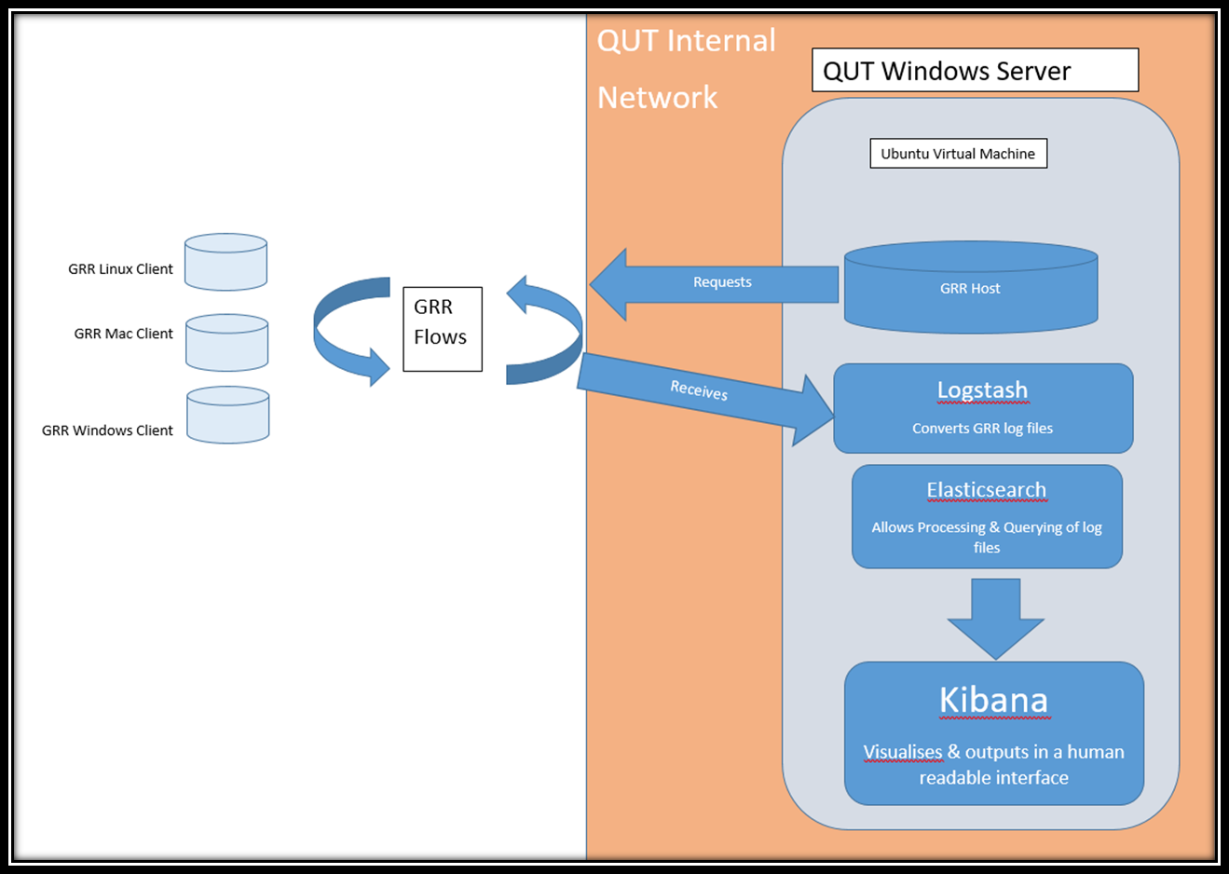
The domain
Incident Response & Live Forensics
Protect the digital assets of businesses & agencies
Scalable, Live, Remote, Open Source and easily interpretable
Conducted a formal Literature Review to ensure an understanding of the project domain

Slide 3
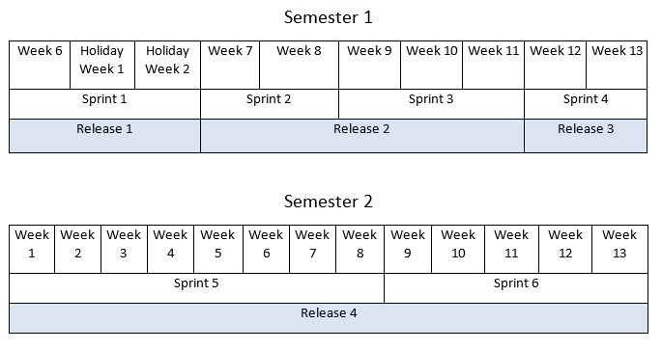
The plan
Release 1 - Early in the semester to assess progress and get feedback
Release 2 - Establish foundations (server configuration, logging)
Release 3 – End of semester, Tests to prove functionality
Release 4 – Visualisation (data selection & manipulation), Installation scripting/automation (stretch goal), GUI, Report Generation (stretch goal)

Slide 4
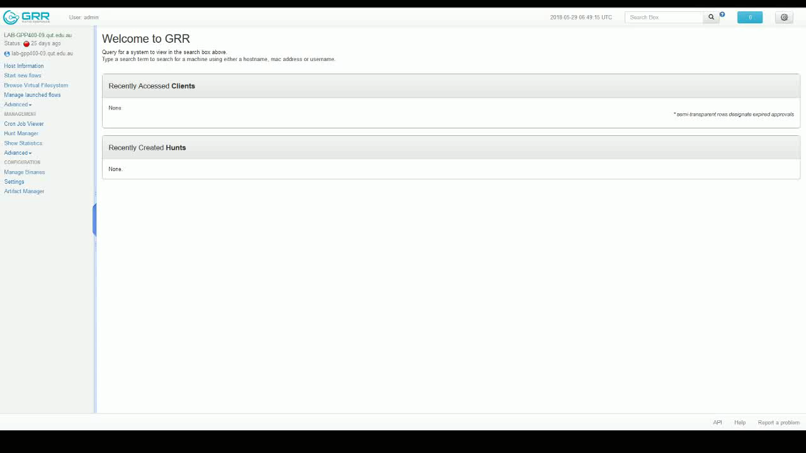

Slide 5
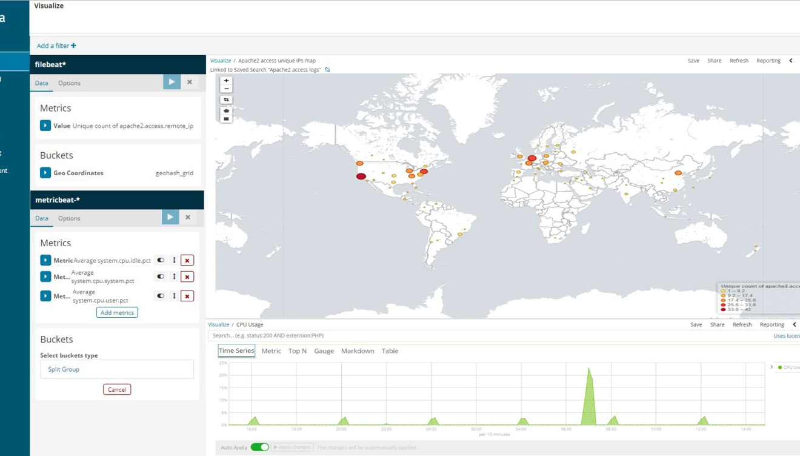
The Artefact
Kibana User Interface
“At a glance” information
Can visualise huge amounts of data
Easily determine health status of network, attack types and origins
Real time

Slide 6
QUALITY
Design Quality | Industry Engagement, Literature Review, Project Management Plan
Process Quality | Meeting Minutes, Progress Tracking, Trello, GitHub, Weekly Meeting with Client
Organisation Quality | Teamwork and Communications, Group Meetings, Different Skills
Three dimensions of quality
Design Quality
Project Quality
Process Quality
Organisation Quality

Slide 7
Credits
Progress tracking: Peijun Xue
Literature review: Peijun Xue, Rui Lin
Industry engagement: Curtis Dooley
GRR server installation: Owen Charters, Curtis Dooley
Virtual network deployment: Owen Charters

